Slide 1
Gemseo formulations and User’s Inputs
27/01/2022
Daniel Margerit
Younes DRISSI

Slide 2
Content
0. Terminology
Definition of the Sobieski optimization Problem
Solve optimization problem
MDF architecture
IDF architecture
Bilevel architecture
Solve DoE optim problem
MDF architecture
Bilevel architecture
Associated user process and GUI tree views
MDO formulations and the power of gemseo
SoSTrades processes and Tree views
Synthèse des informations et des discussions lors de notre reunion de travail du 20/01/2022
Analyse du flux d’inputs et d’actions (réunion du 27/01/2022)
Construction de l’interface adaptée (avec formulation) : on going

Slide 3
0. Terminology

Slide 4
Set up of the used terminology / Definition of your need
So let say:
“You want to create and run your Simulation Problem”:
Create or Select your Unitary Discipline(UD)or “Combined” Discipline (CD)
Define your Simulation Problem (Simple Run/DoE/MDO/…)
Instantiate this Simulation Problem in a Study and use it :
input data (Design Variables and Parameters)
execute
postreat results
Here :
A ”Unitary” Discipline(UD) is a wrapped Discipline
A ”Combined” Discipline(CD)or Discipline Assembly(DA) is a set of connected Disciplines. It is our “set of coupled equations” , our Multi Disciplinary System(MDS).
→ How to do it with a Gemseo GUI ?

Slide 5
Set up of the used terminology / Definition of your need
In the book of Martins & Ning (here) the terminology is as follows:
Multi Disciplinary System = Overall (coupled) System
= Multidisciplinary Model = Coupled disciplines
Coupled system = MDA (Multi Disciplinary Analysis)
System = Overall model = set of disciplines (or components or sub-models) = coupled models.
In case of one model/component/discipline it is a single model/component/discipline
Discipline = Component = Model or Sub-Model
They prefer to use “Component” rather than “Discipline”
We have the system level and the component level.
We can have multiple levels : component, sub-component (discipline, Discipline),… with a hierarchy of components
NB: “Mathematical model” is converted in a “Numerical model” (when an algorithm of solving is selected) and those algorithms are implementing in “solvers”. An analysis consists of one or more numerical models.

Slide 6
Set up of the used terminology / Definition of your need
In the book of Martins & Ning (here) the terminology is as follows :
The optimisation problem for a MultiDisciplinary system is a MDO problem. The objective functions and constraints functions are called “functions of interest”. The equations of the models are the “governing equations”.
A same optimisation problem can be defined (or formulated) in different (mathematically equivalent) ways. It can be solved in the same way it has be firstly defined or in an another equivalent way it has been casted/represented.
They say MDF,IDF, … “architectures” to design the different “methods”/”algorithms” of representing/formulating and/or solving the problem.
In gemseo as in other articles, they are using MDF,IDF, … “formulation”, the mathematical strategy used to define the optimization problem(s) to be solved.

Slide 7
Set up of the used terminology / Definition of your need
In gemseo glossary (here) the terminology is as follows :
Name | Definition
design problem | An engineering problem such that a “shape” (a set of variables) has to be changed to match or improve criteria under constraints
optimization problem | A mathematical problem consisting in finding [the values of ] a set of variables [i.e. the point in Design Space] which minimizes or maximizes a mathematical function, while satisfying constraints on these variables
design variables | The unknowns of the optimization problem
design space | The mathematical set containing the design variables of an optimization problem
[optimization study] | [A mathematical study consisting in solving an optimization problem]
trade-off [study] | A mathematical study consisting in comparing different options [(few selected points in the design space)] in terms of design variables, and analyse their impacts [on the response surface of the studied system]
[exploration study] | A mathematical study consisting in exploring the impact of points in the design space on the response surface of the studied system
Design Of Experiments | In an exploration study, the sampling of a design space, or a generic method that produces samplings of design spaces
Design Of Experiments study | A exploration study consisting in “exploring the design space” based on a sample obtained by a Design Of Experiment

Slide 8
Set up of the used terminology / Definition of your need
In gemseo glossary (here) the terminology is as follows :
Name | Definition
discipline | One program, or an arbitrary set of simulation software, that can be viewed as a mathematical multivalued function, taking inputs and producing outputs through its execution
multidisciplinary problem | A mathematical problem with a set of disciplines
coupling variables | In a set of disciplines, variables that are both used as inputs of a discipline and outputs of another one, or the same discipline
coupled problem | A multidisciplinary problem with coupling variables
MDO formulation | The mathematical strategy used to define the optimization problem(s) to be solved
process | A series of executions and data exchanges, ie the workflow and the data flow.
workflow | The execution sequence of the disciplines in a process
data flow | The sequence of data creation by, and exchanges between disciplines in a process
scenario | The translation of a design problem into an executable. When executed, a scenario generates a process

Slide 9
1. Definition of the Sobieski optimization Problem

Slide 10
Problem definition
disciplines = list of disciplines
Sobieski optimization problem:
maximize the objective function | Range (y_4) from SobieskiMission (id 4)
with respect to design variables | with x inside name
subject to general ineq constraints | with g inside name
subject to bound constraints | for all design variables + coupled variables
where the System Discipline consists | SobieskiStructure (id 1) SobieskiAerodynamics (id 2) SobieskiPropulsion (id 3)

Slide 11
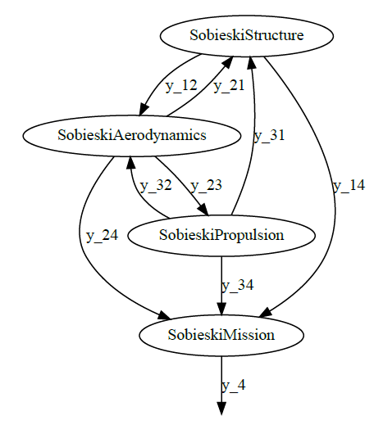
Multi Disciplinary system Coupling variables : graph view

Slide 12
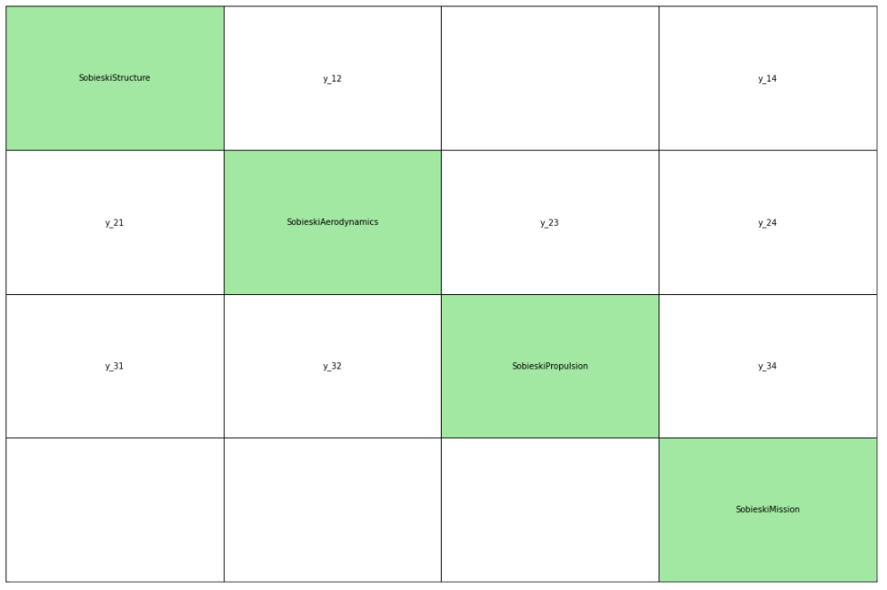
Multi Disciplinary system Coupling variables : N2 view

Slide 13
I/O variables of this Multi Disciplinary system: Inputs and Coupled
Input design variables Coupled variables
x_shared for shared variable y_ij is variable output of discipline I and input of discipline j
x_i is local to discipline of id i
Python variable | Business Variable | Description
x_shared[0] | t/c | Thickness to chord ratio
x_shared[1] | h | Altitude
x_shared[2] | M | Mach number
x_shared[3] | AR = b^2/S_W | Aspect ratio
x_shared[4] | Λ | Wing sweep
x_shared[5] | S_W | Wing surface area
x_1[0] | λ = c_tip/c_root | Wing taper ratio
x_1[1] | x | Wingbox x-sectional area
x_2[0] | C_f | Skin friction coefficient
x_3[0] | Th | Throttle setting (engine mass flow)
Python variable | Business Variable | Description
y_21[0] | L | Lift from aerodynamics
y_31[0] | W_E | Engine mass from propulsion
y_12[0] | W_T | Total aircraft mass from structure
y_12[1] | Δα_v | Wing twist from structure
y_32[0] | ESF | Engine scale factor from propulsion
y_23[0] | D | Drag from aerodynamics
y_24[0] | L/D | Lift-over-drag ratio from aerodynamics
y_14[0] | W_T | Total aircraft mass from structure
y_14[1] | W_F | Fuel mass from structure
y_34[0] | SFC | Specific Fuel Consumption from propulsion

Slide 14
I/O variables of this Multi Disciplinary system : Outputs
Output design variables Global constraints variables
y_i is output of discipline i g_i is output constraints of discipline i
y_11 is a special output of discipline 1
Python variable | Business Variable | Description
y_1[0] | WT | Total aircraft mass
y_1[1] | WF | Fuel mass
y_1[2] | Δα_v | Wing twist
y_11
y_2[0] | L | Lift
y_2[1] | D | Drag
y_2[2] | L/D | Lift-over-drag ratio
y_3[0] | SFC | Specific Fuel Consumption
y_3[1] | W_E | Engine mass
y_3[2] | ESF | Engine Scale Factor
y_4[0] | R | Range
Python variable | Business Variable | Description
g_1[0] | σ1 | Stress constraints on wing section 1
g_1[1] | σ2 | Stress constraints on wing section 2
g_1[2] | σ3 | Stress constraints on wing section 3
g_1[3] | σ4 | Stress constraints on wing section 4
g_1[4] | σ5 | Stress constraints on wing section 5
g_1[5]=y_1[2] | Δα_v | Wing twist
g_2[0] | dp/dx | Pressure gradient
g_3[0]=y_3[2] | ESF | Engine Scale Factor
g_3[1] | T_E | Engine temperature
g_3[2] | Th | Throttle setting constraint

Slide 15
Selected user’s constraints bounds and initial values for Inputs
Input design variables It is coupled variables
This is the design_space variable You need not to be asked to provide them (lb/value/ub columns)
The left column should be provided by the system … if you use a MDF. Yes it is in MDF jupyter notebook but
What is the “value” used for? Initial value or default value ? could be (should be) removed. But the users may whant to
Can I defined also bound in the spec of a discipline? provide it if he knows those bounds and wants to provide them
Python variable | ld | value | ub
x_shared[0] | 0.01 | 0.05 | 0.09
x_shared[1] | 30000 | 45000 | 60000
x_shared[2] | 1.4 | 1.6 | 1.8
x_shared[3] | 2.5 | 5.5 | 8.5
x_shared[4] | 40 | 55 | 70
x_shared[5] | 500 | 1000 | 1500
x_1[0] | 0.1 | 0.25 | 0.4
x_1[1] | 0.75 | 1 | 1.25
x_2[0] | 0.75 | 1 | 1.25
x_3[0] | 0.1 | 0.5 | 1.25
Python variable | lb | value | ub
y_21[0] | 24850 | 50606.9741711 | 77250
y_31[0] | 2960 | 6354.32430691 | 10185
y_12[0] | 24850 | 50606.9742 | 77250
y_12[1] | 0.45 | 0.95 | 1.5
y_32[0] | 0.235 | 0.5027962499999999 | 0.795
y_23[0] | 3365 | 12194.2671934 | 26400
y_24[0] | 0.44 | 4.15006276 | 11.13
y_14[0] | 24850 | 50606.9741711 | 77100
y_14[1] | -7700 | 7306.20262124 | 45000
y_34[0] | 0.44 | 1.10754577 | 1.98

Slide 16
2. Solve optimization problem

Slide 17
MDF architecture (optim)

Slide 18
Scenario input selection and options
What if I want to have only optim variables 'x_shared', 'x_1‘ and fixed provided values of 'x_2', 'x_3‘ ?
In python you can:
- your selected fixed values for 'x_2', 'x_3‘ by changing the “default values” in your design space “instance”
- Then filter the design space on those two variables 'x_shared', 'x_1‘
scenario | Value
scenario_type | MDO
formulation | MDF
objective_name | y_4
maximize_objective | True
design_space | design_space
System | disciplines
MDF options | See next
constraints | g1,g2,g3 ineq
MDF options | Value
'tolerance' | 1e-10
'max_mda_iter' | 50
'warm_start' | True
'use_lu_fact' | True
'linear_solver_tolerance' | 1e-15
Here are only part of the options !
There are default options used … that can be also changed

Slide 19
MDF Options Default
'maximize_objective': False,
'grammar_type': 'JSONGrammar',
'main_mda_class': 'MDAChain',
'sub_mda_class': 'MDAJacobi
You also have sub_options

Slide 20
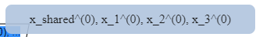
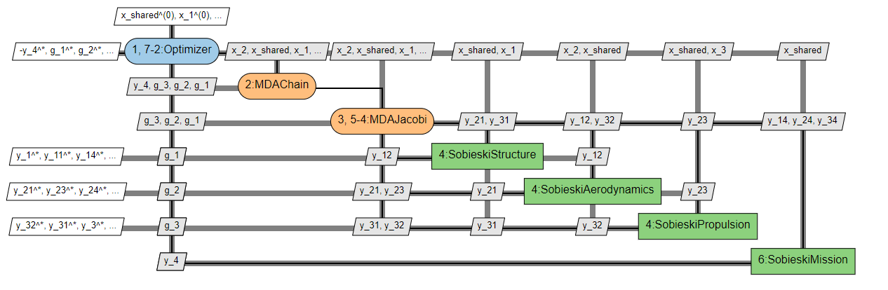
XDSM visualization of this algorithm
It has been pointed out that you have this because you have selected MDF and that what has been used for formulation options are the default values (and so for example we get MDAChain + MDAJacobi). You may change it and have a single MDAJacobi instead.

Slide 21
Multi Disciplinary system Coupling variables : graph view
SobieskiStructure
y_12
y_21
MDAJacobi
SobieskiAerodynamics
y_31
y_23
y_14,y_24,y34
y_32
SobieskiPropulsion
SobieskiMission
MDAJacobi Discipline
MDAChain Discipline

Slide 22
Resulting simulation problem to be solved
Sobieski optimization problem:
minimize the objective variable | -y_4(x_shared, x_1, x_2, x_3)
with respect to optim variables | 'x_shared', 'x_1', 'x_2', 'x_3'
subject to general ineq constraints | g_1(x_shared, x_1, x_2, x_3) <= 0.0 g_2(x_shared, x_1, x_2, x_3) <= 0.0 g_3(x_shared, x_1, x_2, x_3) <= 0.0
subject to bound constraints | for all optim variables (values provided from filtered design space on optim variables)
where the System Discipline consists | SobieskiStructure (id 1) SobieskiAerodynamics (id 2) SobieskiPropulsion (id 3) SobieskiMission (id 4)

Slide 23
Scenario (executable inputs)
Exe options | Value
'max_iter' | 10
'algo' | "SLSQP"
SLSQP algo options | Value
"ftol_rel" | 1e-10
"ineq_tolerance" | 2e-3
"normalize_design_space" | True

Slide 24
IDF architecture (optim)

Slide 25
Scenario input selection and options
scenario | Value
scenario_type | MDO
formulation | IDF
objective_name | y_4
maximize_objective | True
design_space | design_space
System | disciplines
IDF options | Default
constraints | g1,g2,g3 ineq

Slide 26
IDF Options Default
'normalize_constraints': True,
'grammar_type': 'JSONGrammar',
'parallel_exec': False ,
'start_at_equilibrium': False,
'use_threading': True
You also have no sub_options

Slide 27
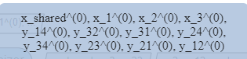
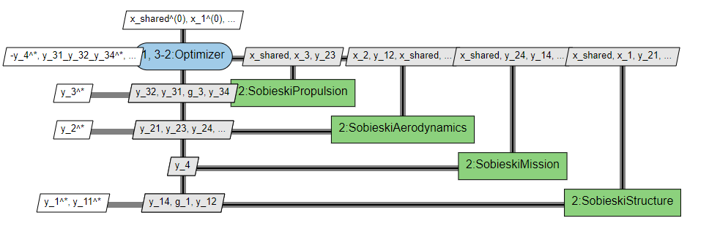
XDSM visualization of this algorithm

Slide 28
Optimization problem to be solved
Sobieski optimization problem:
minimize the objective variable | -y_4(x_shared, y_14, y_24, y_34)
with respect to optim variables | x_shared, x_1, x_2, x_3, y_14, y_32, y_31, y_24, y_34, y_23, y_21, y_12
subject to general ineq constraints | g_1(x_shared, x_1, y_31, y_21) <= 0.0 g_2(x_shared, x_2, y_32, y_12) <= 0.0 g_3(x_shared, x_3, y_23) <= 0.0 y_31_y_32_y_34(x_shared, x_3, y_23): y_31(x_shared, x_3, y_23) - y_31 == 0.0 y_32(x_shared, x_3, y_23) - y_32 == 0.0 y_34(x_shared, x_3, y_23) - y_34 == 0.0 y_21_y_23_y_24(x_shared, x_2, y_32, y_12): y_21(x_shared, x_2, y_32, y_12) - y_21 == 0.0 y_23(x_shared, x_2, y_32, y_12) - y_23 == 0.0 y_24(x_shared, x_2, y_32, y_12) - y_24 == 0.0 y_12_y_14(x_shared, x_1, y_31, y_21): y_12(x_shared, x_1, y_31, y_21) - y_12 == 0.0 y_14(x_shared, x_1, y_31, y_21) - y_14 == 0.0
subject to bound constraints | for all optim variables (values provided from filtered design space on optim variables)
where the System Discipline consists | SobieskiStructure (id 1) SobieskiAerodynamics (id 2) SobieskiPropulsion (id 3) SobieskiMission (id 4)

Slide 29
Selected user’s constraints bounds and initial values for Coupled
Coupled variables
The left column should be provided by the system.
It is needs here to be added in the design space as design variables for this IDF formulation.
How do you find those lb/value/ub values ?
The user know them because those variables usually have physical meaning for the user.
You should provide bounds if you have bounds so that those variables can be normalized.
Python variable | lb | value | ub
y_21[0] | 24850 | 50606.9741711 | 77250
y_31[0] | 2960 | 6354.32430691 | 10185
y_12[0] | 24850 | 50606.9742 | 77250
y_12[1] | 0.45 | 0.95 | 1.5
y_32[0] | 0.235 | 0.5027962499999999 | 0.795
y_23[0] | 3365 | 12194.2671934 | 26400
y_24[0] | 0.44 | 4.15006276 | 11.13
y_14[0] | 24850 | 50606.9741711 | 77100
y_14[1] | -7700 | 7306.20262124 | 45000
y_34[0] | 0.44 | 1.10754577 | 1.98

Slide 30
Scenario (executable inputs)
Exe options | Value
'max_iter' | 20
'algo' | "SLSQP"
SLSQP algo options | Value
"ftol_rel" | 1e-10
"ineq_tolerance" | 2e-3
"eq_tolerance" | 1e-3
"normalize_design_space" | True

Slide 31
Bilevel architecture (optim)

Slide 32
Sub-scenarios input selection and options
scenario | Value
scenario_type | MDO
name | PropulsionScenario
formulation | DisciplinaryOpt
objective_name | y_34
maximize_objective | True
design_space | Line of variable x_3 of design_space
System | "SobieskiPropulsion"
Formulation options
constraints | g_3 ineq
scenario | Value
scenario_type | MDO
name | AerodynamicsScenario
formulation | DisciplinaryOpt
objective_name | y_24
maximize_objective | True
design_space | Line of variable x_2 of design_space
System | SobieskiAerodynamics
Formulation options
constraints | g_2 ineq
scenario | Value
scenario_type | MDO
name | StructureScenario
formulation | DisciplinaryOpt
objective_name | y_11
maximize_objective | True
design_space | Line of variable x_1 of design_space
System | SobieskiStructure
Formulation options
constraints | g_1 ineq
Sub-scenario prop
Sub-scenario aero
Sub-scenario struc
In the jupyter notebook this is created by the user for each coupled discipline.
Do I have to do it as a user or should it be done automatically by the system?
Answer :
there is no automatization provided today but it could be good to have them to create quickly several bilevel.
however if those created are not suitable for your problem, you need from the GUI to be able to be able to built any kind of possible bilevel formulation

Slide 33
Overall scenario input selection and options
scenario | Value
scenario_type | MDO
name
formulation | "BiLevel"
objective_name | y_4
maximize_objective | True
design_space | Line of variable x_shared of design_space
System | Sub-scenario prop Sub-scenario aero Sub-scenario struc SobieskiMission (id 4)
Bilevel options | See next
constraints | "g_1", "g_2", "g_3 ineq
Bilevels options | Value
'tolerance' | 1e-10
'max_mda_iter' | 50
apply_cstr_tosub_scenarios | False
parallel_scenarios | False
multithread_scenarios | True
Scenario mission

Slide 34
Overall scenario input selection and options
Exe options | Value
'max_iter' | 30
'algo' | "SLSQP"
Exe options | Value
'max_iter' | 50
'algo' | "NLOPT_COBYLA"
Optim algo options | Value
"xtol_rel" | 1e-7
"xtol_abs" | 1e-7
"ftol_rel" | 1e-7
"ftol_abs" | 1e-7
"ineq_tolerance" | 1e-4
Executable default inputs:
prop, aero, struc
Executable inputs:
mission
Executable default inputs:
prop, aero, struc, mission

Slide 35
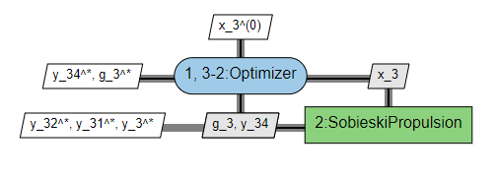
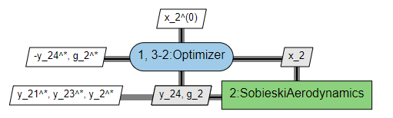
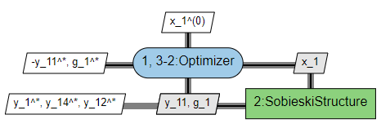
XDSM visualization of this algorithm
Sub-scenario prop
Sub-scenario aero
Sub-scenario struc

Slide 36
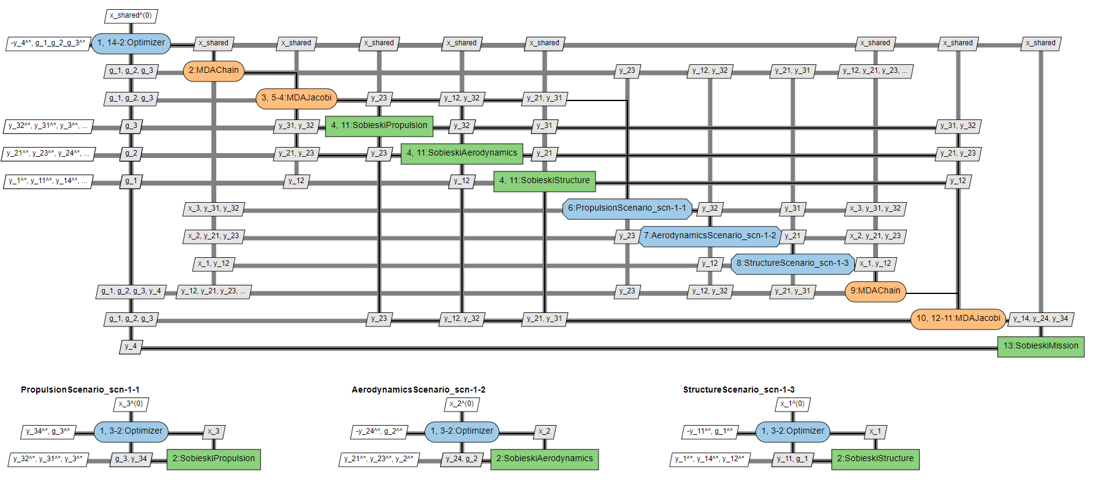
XDSM visualization of this algorithm
Scenario mission
Here is only an example of bilevel that can be created.
Also there are default options used … that can be also changed

Slide 37
Resulting simulation problem to be solved
Scenario prop optimization problem:
minimize the objective variable | y_34(x_3)
with respect to optim variables | x_3
subject to general ineq constraints | g_3(x_3) <= 0.0
subject to bound constraints | for optim variable x_3 line in DS
where the System Discipline consists | SobieskiPropulsion (id 3)
Scenario struct optimization problem:
minimize the objective variable | -y_11(x_1)
with respect to optim variables | x_1
subject to general ineq constraints | g_1(x_1) <= 0.0
subject to bound constraints | for optim variable x_1 line in DS
where the System Discipline consists | SobieskiStructure (id 1)
Scenario aero optimization problem:
minimize the objective variable | -y_24(x_2)
with respect to optim variables | x_2
subject to general ineq constraints | g_2(x_2) <= 0.0
subject to bound constraints | for optim variable x_2 line in DS
where the System Discipline consists | SobieskiAerodynamics (id 2)
Scenario mission optimization problem:
minimize the objective variable | -y_4(x_shared)
with respect to optim variables | x_shared
subject to general ineq constraints | g_1_g_2_g_3(x_shared) <= 0.0
subject to bound constraints | for optim variable x_shared line in DS
where the System Discipline consists | Sub-scenario prop Sub-scenario aero Sub-scenario struc SobieskiMission (id 4)

Slide 38
3. Solve doe optim problem

Slide 39
DoE vs DoE optim
What if I want to do a simple DoE without any optimization function ?
Answer:
Cette variable sélectionnée est d’avantage « un observable » particulier qu’une fonction objective.
On demande à l’utilisateur de mettre le focus sur une des colonnes de la tables des résultats de simulation.
Par défaut la valeur minimale de cette variable sera fournie.
François : Aujourd’hui c’est obligatoire car “en general” l’utilisateur en à besoin … ou “devrait” en avoir besoin …

Slide 40
MDF architecture (doe optim)

Slide 41
Scenario input selection and options
scenario | Value
scenario_type | DOE
formulation | MDF
objective_name | y_4
maximize_objective | True
design_space | design_space
System | disciplines
MDF options | See next
constraints | g1,g2,g3 ineq
Same as MDO
except for scenario-type

Slide 42
XDSM visualization of this algorithm
Same as MDO

Slide 43
Resulting simulation problem to be solved
Sobieski optimization problem:
minimize the objective variable | -y_4(x_shared, x_1, x_2, x_3)
with respect to optim variables | 'x_shared', 'x_1', 'x_2', 'x_3'
subject to general ineq constraints | g_1(x_shared, x_1, x_2, x_3) <= 0.0 g_2(x_shared, x_1, x_2, x_3) <= 0.0 g_3(x_shared, x_1, x_2, x_3) <= 0.0
subject to bound constraints | for all optim variables (values provided from filtered design space on optim variables)
where the System Discipline consists | SobieskiStructure (id 1) SobieskiAerodynamics (id 2) SobieskiPropulsion (id 3) SobieskiMission (id 4)
Same as MDO

Slide 44
Scenario (executable inputs)
Exe options | Value
'n_samples' | 30
'algo' | 'lhs'
Specific to DoE
LHS algo options | Value
"criterion" | "center"
'eval_jac' | True
"n_processes" | 1

Slide 45
Bilevel architecture (doe optim)

Slide 46
Sub-scenarios input selection and options
Same as MDO
scenario | Value
scenario_type | MDO
name | PropulsionScenario
formulation | DisciplinaryOpt
objective_name | y_34
maximize_objective | True
design_space | Line of variable x_3 of design_space
System | "SobieskiPropulsion"
Formulation options
constraints | g_3 ineq
scenario | Value
scenario_type | MDO
name | AerodynamicsScenario
formulation | DisciplinaryOpt
objective_name | y_24
maximize_objective | True
design_space | Line of variable x_2 of design_space
System | SobieskiAerodynamics
Formulation options
constraints | g_2 ineq
scenario | Value
scenario_type | MDO
name | StructureScenario
formulation | DisciplinaryOpt
objective_name | y_11
maximize_objective | True
design_space | Line of variable x_1 of design_space
System | SobieskiStructure
Formulation options
constraints | g_1 ineq
Sub-scenario prop
Sub-scenario aero
Sub-scenario struc

Slide 47
Overall scenario input selection and options
scenario | Value
scenario_type | DOE
name
formulation | "BiLevel"
objective_name | y_4
maximize_objective | True
reset_x0_before_opt | True
design_space | Line of variable x_shared of design_space
System | Sub-scenario prop Sub-scenario aero Sub-scenario struc SobieskiMission
Bilevel options | See next
constraints | "g_1", "g_2", "g_3 ineq
Bilevels options | Value
'tolerance' | 1e-10
'max_mda_iter' | 50
apply_cstr_tosub_scenarios | False
parallel_scenarios | False
multithread_scenarios | True
mda1.warm_start | False
mda2.warm_start | False
Scenario mission

Slide 48
Overall scenario input selection and options
Exe options | Value
'max_iter' | 20
'algo' | "L-BFGS-B"
Exe options | Value
'n_samples' | 30
'algo' | "lhs"
Executable default inputs:
prop, aero, struc, mission
Executable inputs:
mission
Specific to DoE

Slide 49
XDSM visualization of this algorithm
Same as MDO
Sub-scenario prop
Sub-scenario aero
Sub-scenario struc

Slide 50
XDSM visualization of this algorithm
Scenario mission
Same as MDO

Slide 51
Resulting simulation problem to be solved
Scenario prop optimization problem:
minimize the objective variable | y_34(x_3)
with respect to optim variables | x_3
subject to general ineq constraints | g_3(x_3) <= 0.0
subject to bound constraints | for optim variable x_3 line in DS
where the System Discipline consists | SobieskiPropulsion (id 3)
Scenario struct optimization problem:
minimize the objective variable | -y_11(x_1)
with respect to optim variables | x_1
subject to general ineq constraints | g_1(x_1) <= 0.0
subject to bound constraints | for optim variable x_1 line in DS
where the System Discipline consists | SobieskiStructure (id 1)
Same as
MDO
Scenario aero optimization problem:
minimize the objective variable | -y_24(x_2)
with respect to optim variables | x_2
subject to general ineq constraints | g_2(x_2) <= 0.0
subject to bound constraints | for optim variable x_2 line in DS
where the System Discipline consists | SobieskiAerodynamics (id 2)
Scenario mission optimization problem:
minimize the objective variable | -y_4(x_shared)
with respect to optim variables | x_shared
subject to general ineq constraints | g_1_g_2_g_3(x_shared) <= 0.0
subject to bound constraints | for optim variable x_shared line in DS
where the System Discipline consists | Sub-scenario prop Sub-scenario aero Sub-scenario struc SobieskiMission (id 4)

Slide 52
4. Associated user process and GUI Tree views

Slide 53
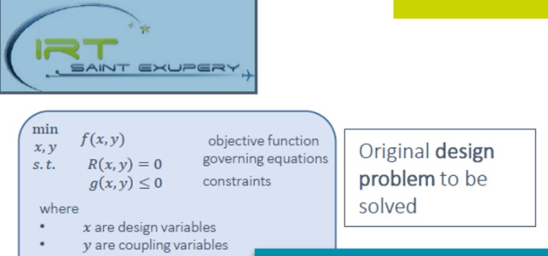
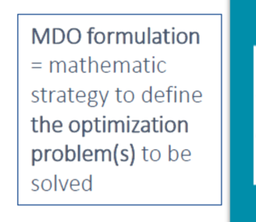
Global DoE/MDAO business process (Chevron view)
(extracted from DOE-MDAO-FWs_Func-Map)
1. Define a simulation problem (SP)
2. Define the strategy to solve the simulation problem (SP)
Model
creation
Wrap model
1.1 Define a Multi
Disciplinary System
1.2 Define a SP Simulation Problem (Exploration DoE or optim MDO or Trade off SoS)
2.1 For optim select the equivalent reformulation (strategy of solving): type of formulation
2.2 Choose your algorithms.
Choose fixed design variables
Define a simulation problem (SP)
Define the strategy to solve the simulation problem (SP)
Is it?:
A) a two steps process
Define E.g. Study prototyping
Solve
Or
B) and not a single step Define and Solve in a single step process ?
Answer : Sometimes A and sometimes B depending on the user

Slide 54
Global DoE/MDAO business process (Chevron view)
(extracted from DOE-MDAO-FWs_Func-Map)
Study pre-treatment
Study execution
Study post-treatment
Data Creation
Data Analysis and Display
Provide Study inputs
Run Study
Data Analysis and Display
Surrogate model discipline
Instantiate Study from SP
Perform your Study process

Slide 55
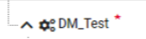

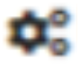
Simulation Problem definition
Optimisation
Doe
MDS
MDS
SobieskiStructure
SobieskiStructure
SobieskiAerodynamics
SobieskiAerodynamics
SobieskiPropulsion
SobieskiPropulsion
SobieskiMission
SobieskiMission
Optimization problem definition
Doe problem definition

Slide 56

Strategies to solve the simulation Problem
Optimization
MDAChain
MDAJacobi
SobieskiStructure
SobieskiAerodynamics
SobieskiPropulsion
SobieskiMission
MDF for optimization
IDF for optimization
Bilevel for optimization

Slide 57
5. MDO formulations and the power of gemseo

Slide 58
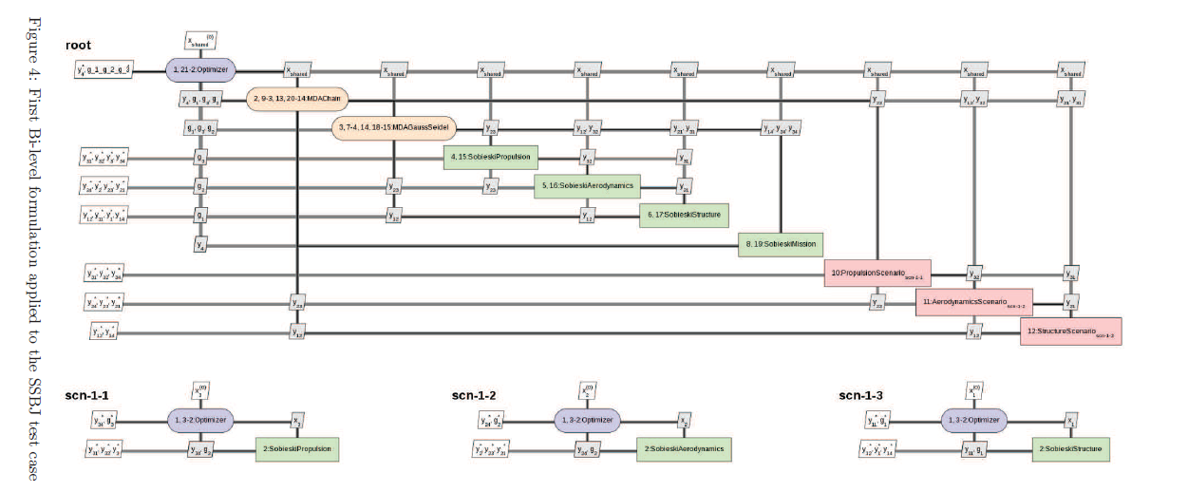
Pas de MDA : comment on le fait ?
Il faut le “plugin privé airbus”!

Slide 59
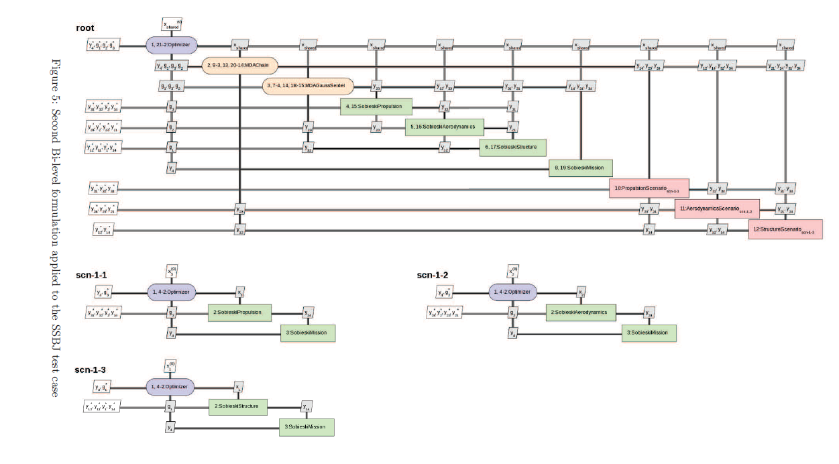

Slide 60
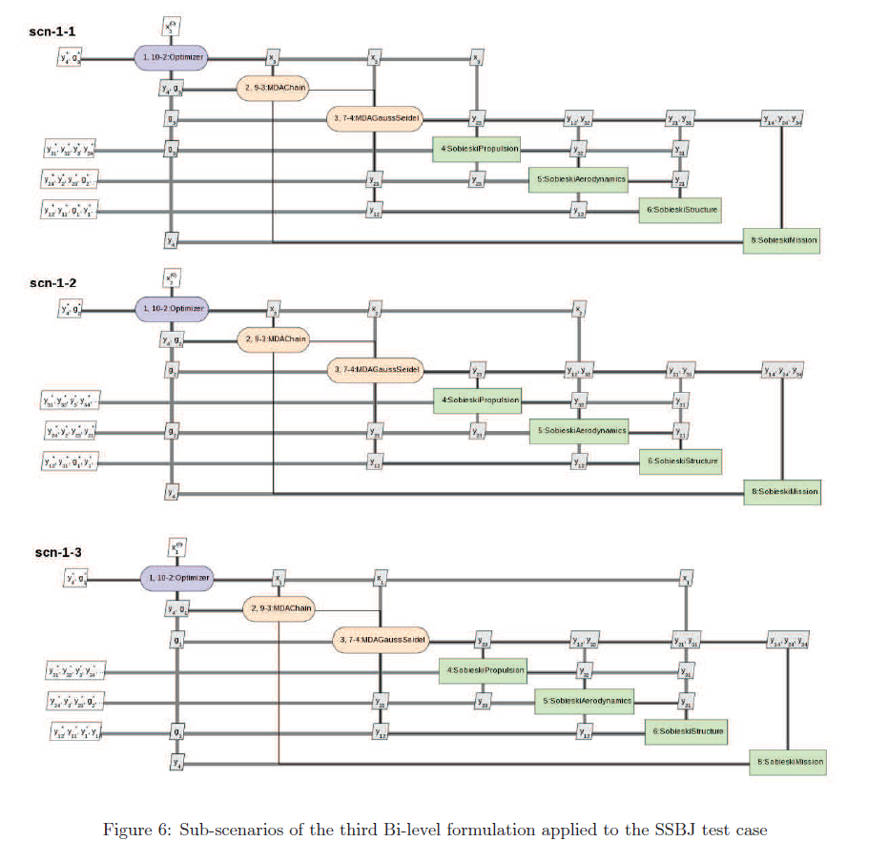

Slide 61
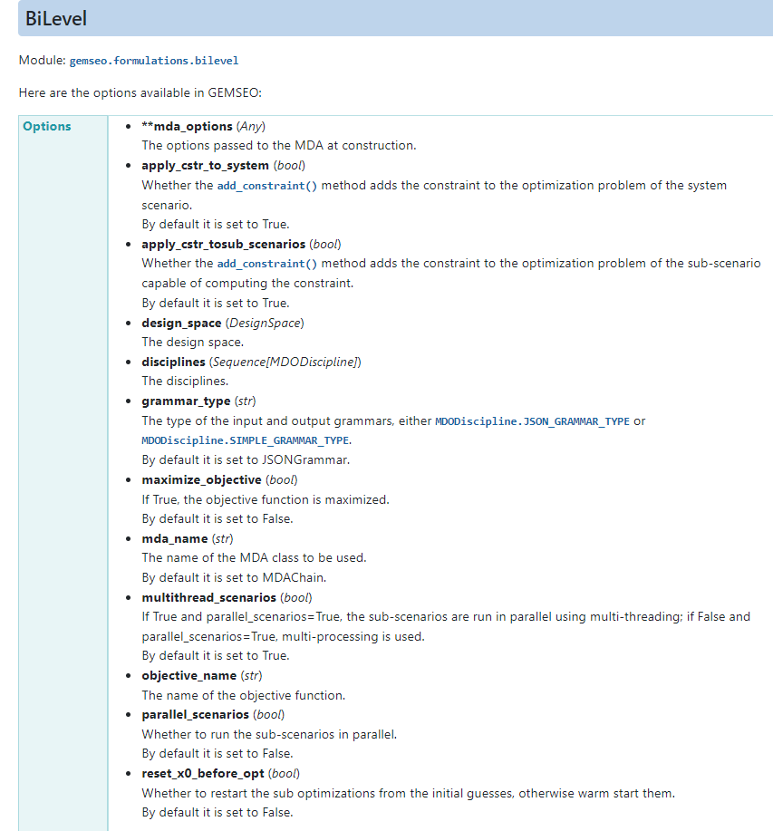

Slide 62
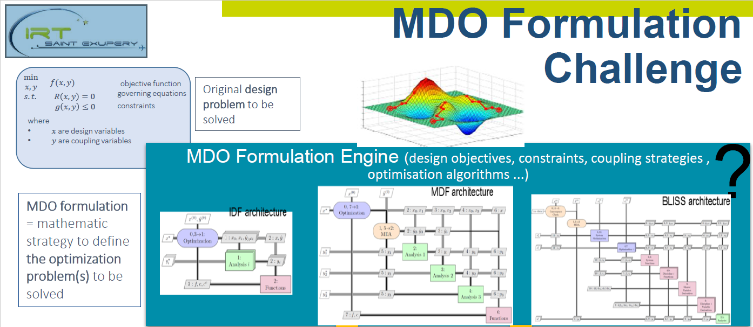
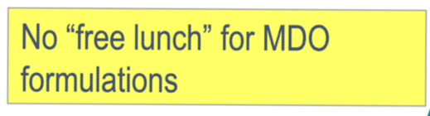

Slide 63
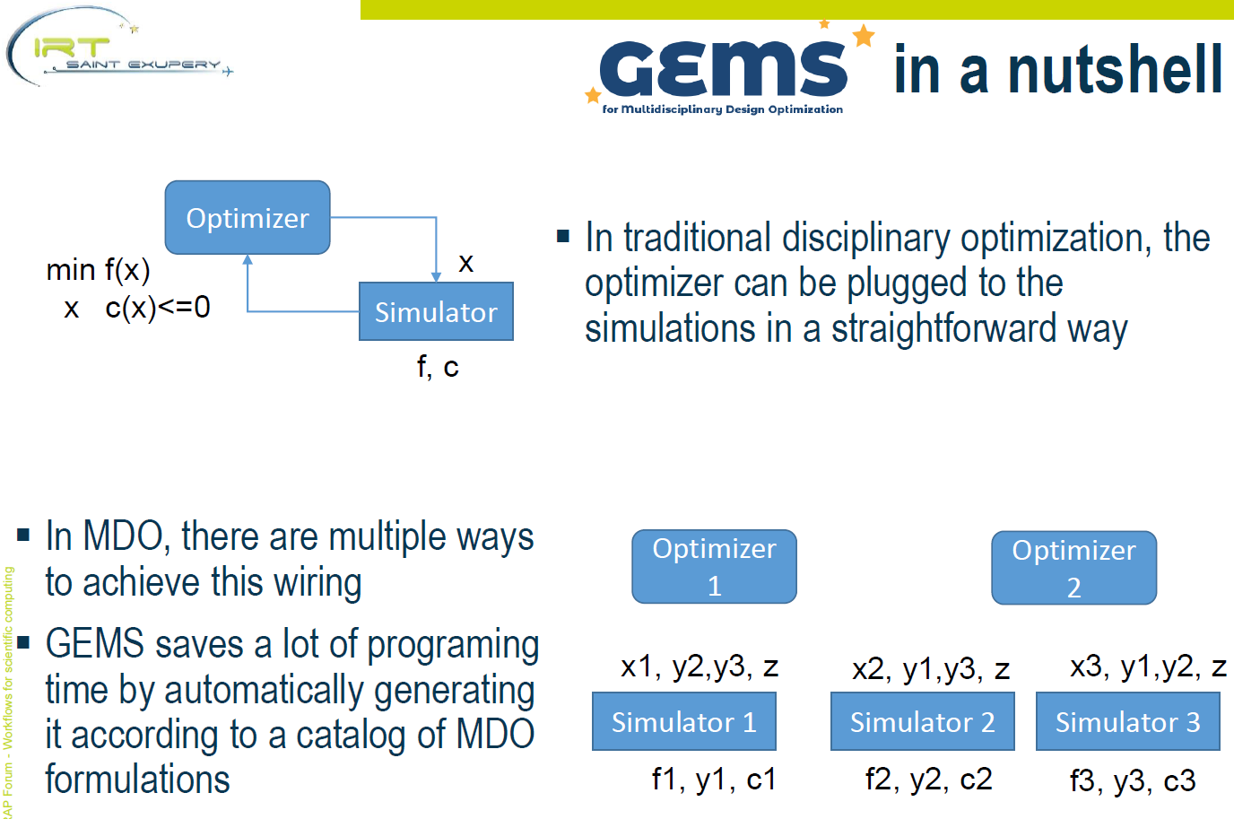

Slide 64
GEMS vs OpenMDAO
For these reasons, GEMS was developed with multi-level MDO formulations as an important use case, with the possibility to reuse existing black-box optimization software. This is a substantial difference with NASA's OpenMDAO, which mainly targets MDF and IDF since the rewriting of the code for version 1.0.0
(GEMS: A Python Library for Automation of Multidisciplinary Design Optimization ProcessGeneration p2)
The Benders decomposition (1962) is a keystone for two multi-level methods :
See “GEMS, a Generic Engine for MDO Scenarios: Key Features In Application” p6
see also Programmation mathématique Minoux Tome 2 p89 (Problèmes de type 2 structure bloc diagonale avec variables couplantes)

Slide 65
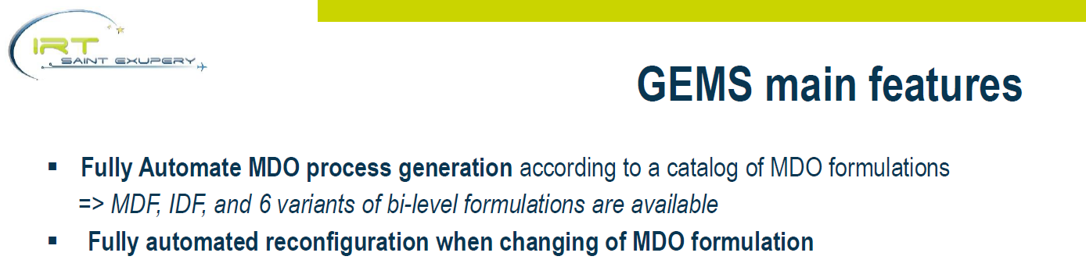
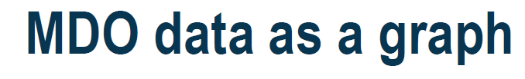
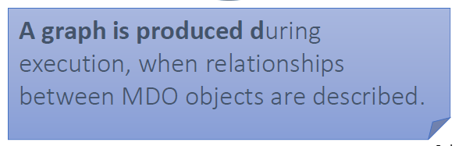
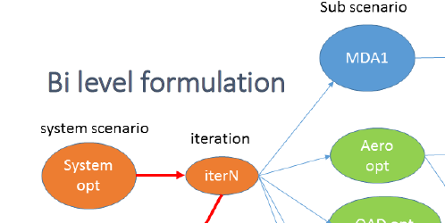
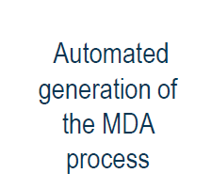

Slide 66
6. SoSTrades processes and Tree views What about the complementarity/convergence with SoSTrades functions and GUI?

Slide 67
SoSTrades list of processes
SoSTrades available processes | Type
create_builder_list
create_evaluator_builder
create_architecture_builder
create_value_block_builder
create_scatter_builder
create_multi_scatter_builder_from_list
create_very_simple_multi_scenario_builder
create_simple_multi_scenario_builder
create_multi_scenario_builder
create_builder_coupling
create_optim_builder | Optimization (MDOScenario)
create_deo_builder | Doe optim (DOEScenario)

Slide 68
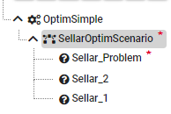
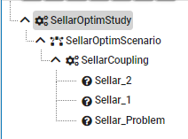
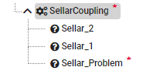
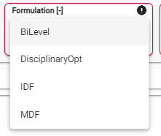
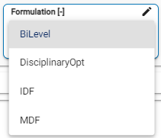
Tree views : optim process
Sellar coupling = MDAJacobi
Optimization on MDS
Optimization on SellarCoupling
Associated GUI user input
Associated GUI user input
Apparait dans l’interface de SoSTrades mais n’est pas connecté et disponible.
Ca signifie MDF seulement ? (à vérifier)
68

Slide 69
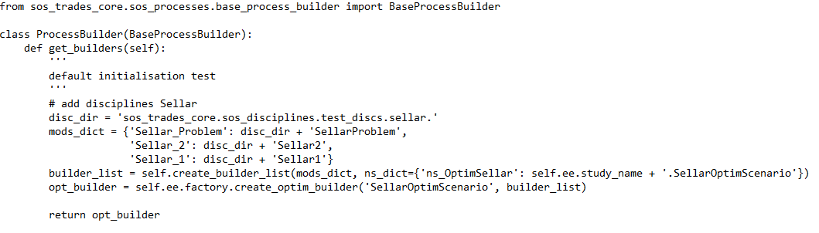
Simulation process Builder in python : e.g. Optimization on MDF
Implementation :
{MDO + formulation}
Implementation based on
MDOScenario (rem: equiv for DOE is DOEScenario)
OptimizersFactory (rem: equiv for DOE is DOEFactory)
MDOFormulationsFactory
Study name
Optim Builder
Builder List

Slide 70
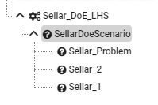
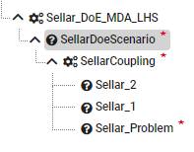
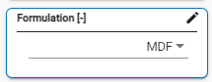
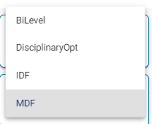
Tree views : doe optim
DoE on MDS
DoE on SellarCoupling

Slide 71
Doe in SoSTrades
SoSDOEScenario
Advantages: Fully using GEMSEO implementation
Drawbacks: need to implement an MDOFormulation for a DOE
{DOE + formulation}
In all books or lectures on doe I have looked,
they never need or speak about formulation ...
Do you have references on this subject ?
SoSDOE_Eval
Advantages: Using DOE wrapper in GEMSEO
No MDO Formulation required for a DOE
Output as a dataframe for all evaluations
Drawbacks: Divergence with GEMSEO implementation (which is strange)

Slide 72
Doe in SoSTrades
SoSDOEScenario
How it is done : (direct integration in SoSTrades)
Use DOEScenario.__init__ to create the doe scenario
Define a _run_algorithm function that creates the algo option
from lib = self._algo_factory.create(algo_name) and execute it.
It is using self.ALGO_OPTIONS
3. DOEScenario._run(self) to run the scenario by using previous _run_algorithm
How it is done :
Creation of the sample :
1a) In the case of Custom DOE they do not use gemseo to create the sample
Here samples_df is construct directly or form a file and put in disc_dict[
1b) In case of Doe with algo :
- use get_algo_options to get the options
- use self.doe_factory.create(algo_name)
(where doe_factory is based on DOEFactory() of Gemseo)
to create the sample from doe algo but not create a gemseo scenario.
2. Then the run on this sample is done
- without gemseo DOEScenario
- but with SoSTrades capabilities
SoSDOE_Eval
D’après François :
C’est indirectement une
« réimplémentation de MDF »
plutôt que utilisation du MDF de gemseo ..

Slide 73
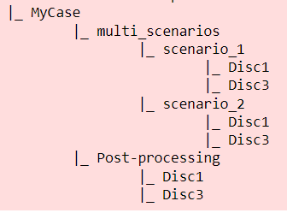
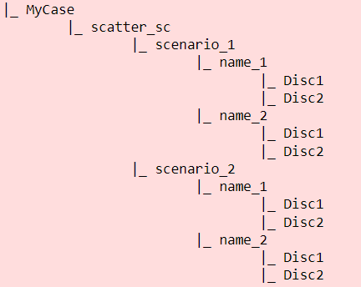
Tree views : other processes

Slide 74
7. Synthèse des informations et des discussions lors de notre reunion de travail du 20/01/2022

Slide 75
Une première liste de besoins utilisateur déjà couverts pas la maquette proposée
Le but est que l’utilisateur puisse :
Exprimer et explorer simplement son problème de design et d’optimisation associée en bénéficiant des fonctionnalités de gemseo : exploration des variables (libre, couplées, …) et des couplages de disciplines. Il peut donc être amener d’abord d’exprimer/de définir/d’explorer son problème dans une première version simple (« original problem » specification) :
Visualisation par la table des variables et leurs « status » naturel : libre, couplée, ….
Visualisation par graphe ou N2 plot
Visualisation arborescente
Question : est-il possible d’avoir une visualisation XDSM plus rapidement (première visualisation avec les valeurs par défaut d’un MDF?). Utile ou pas ?

Slide 76
Une première liste de besoins utilisateur déjà couverts pas la maquette proposée
Le but est que l’utilisateur puisse :
Faire du « study prototyping ». Les utilisateurs peuvent avoir besoins dans les phases amonts de faire du « study prototyping » sur leur disciplines (même parfois sans avoir de run définit pour une discipline) : c’est-à-dire explorer les variable et les couplages
Pouvoir résoudre un problème d’optimisation ou de doe simplement tel qu’énoncé naturellement (« original problem » specification) en utilisant les options de défaut de gemseo (MDF avec options default).
Ces fonctionnalités sont déjà prises en comptes dans la proposition d’interface actuelle qui avait été inspirée de Whatsopt/OpenMDAO qui adresse les formulations de types MDF/IDF.

Slide 77
Oui mais ….
Cependant cette résolution simple ne sera possible ou efficace que pour des problèmes simples.
Pour des problèmes plus complexes (tels que souvent rencontrés dans l’industrie), l’utilisateur aura alors besoin d’utiliser d’autres algorithmes, formulations et options adaptées à son problème sinon la phase de résolution ne sera pas efficace.
C’est une des fonctions clefs fournies par gemseo et pas forcément disponibles sur d’autres plateformes de MDO : la possibilité de proposer/de construire efficacement et rapidement d’autres formulations plus complexes (bilevel , …, mélange de plusieurs formulations …) qui vont permettre à l’utilisateur de résoudre son problème plus efficacement, en moins longtemps ou sur un temps désormais possible.

Slide 78
Une deuxième liste de besoins utilisateur disponibles dans Gemseo mais non déjà couverts pas la maquette proposée
Le but est donc que l’utilisateur puisse aussi : en allant du plus simple au plus sophistiqué
Choisir d’autres options pour sa formulation MDF (choix de MDA différents ou/et ou d’algorithmes de MDA différents, …) en modifiant les options par défaut du MDF
Choisir et modifier les options d’une formulation IDF
Dans le cas général il doit pouvoir conjointement à la définition de sa formulation :
Rajouter des designs variables à partir de variables couplées
Répartir ainsi le rôle des variables en fonction de la formulation que l’on veut construire
Les algorithmes de formulation utilisent entre autre une décomposition par partitionnement des variables (e.g. Blenders). D’autres algorithmes utilisent une décomposition par les prix (e.g. Dantzig-Wolfe) ou par les ressources. Il est donc important de proposer un principe de partitionnent de la table des variables
Pouvoir mélanger les formulations sur un problème plus complexe
Pouvoir (dans le cadre d’un utilisateur plus expérimenté) créer rapidement son problème et sa formulation adéquate : arriver rapidement vers cette formulation finale sans devoir ressaisir 2 fois la même chose ou devoir être contraint de faire une première étape préparatoire qui serait une contrainte imposée pour lui (si c’était le cas). Il faut qu’il puisse faire sa construction simplement en évitant trop « d’allers-retours».

Slide 79
Attention …
Il faut pouvoir rajouter ces fonctionnalités dans le GUI proposée en restant « user’s friendly » :
Que l’utilisateur puisse toujours saisir/définir/explorer/résoudre et faire simplement un cas simple
Que l’utilisateur puisse toujours saisir/définir explorer/tenter de lancer la résolution simplement d’un cas complexe
Que l’utilisateur puisse reformuler de façon abordable son problème différemment (à base de formulations et scénarios) pour obtenir une résolution efficace de son problème
Qu’un utilisateur expérimenté puisse créer rapidement la formulation complexe dont il a besoin
A-t-on besoin d’un mode expert (comme dans SoSTrades) pour filtrer l’interface en limitant les inputs (nombres d’options possibles offertes …) pour un utilisateur non expert?

Slide 80
Au sujet de la table des variables (… du « design space »)
Il faut pouvoir traiter un grand nombre de variables
Dans le cas d’un MDF, il faut que le système donne la visibilité sur les variables libre et couplées pour que l’utilisateur :
Puisse décider quelles variables il vaut laisser libre et pouvoir donner une valeur fixe aux variables qu’il veut ne pas faire varier.
Pour les variables gardées libres (gardé dans le design space), il donnera des bornes (les bornes physiques connues de cette variable) car elles sont utilisées dans la normalisation
Dans le cas général il doit pouvoir conjointement à la définition de sa formulation :
Rajouter des designs variables à partir de variables couplées
Répartir ainsi le rôle des variables en fonction de la formulation que l’on veut construire
Les algorithmes de formulation utilisent une décomposition par partitionnement des variables (e.g. Blenders). D’autres algorithmes utilisent une décomposition par les prix (e.g. Dantzig-Wolfe) ou par les ressources. Il est donc important de proposer un principe de partitionnent de la table des variables : découpe, filtrage …
Les variables de la table proviennent des disciplines sélectionnées lorsqu’il y en a
On veut aussi pouvoir ajouter des variables qui ne proviennent pas de disciplines (To Be Confirmed):
En définissant dans le gui (ou chargeant un fichier) de design space
Car l’utilisateur connait des bounds pour ces variables et veut les renseigner
Elles serviront alors lors de la création de disciplines
Ou devront être synchronisées avec l’ajout de disciplines

Slide 81
8. Analyse du flux d’inputs et d’actions Pour la réunion du 27/01/2022

Slide 82
Exploration des jeux de paramètres : MDO/DOE Options
MDO or DOE
'linearization_mode’
'jac_approx_type‘
'jax_approx_step‘
'jac_approx_use_threading‘
'jac_approx_wait_time'
'cache_type‘
'cache_hdf_file‘
'cache_hdf_node_name‘
'name‘
'grammar_type'

Slide 83
Exploration des jeux de paramètres : Bilevel Options Default
'maximize_objective': False,
'mda_name': 'MDAChain',
'parallel_scenarios': False,
'multithread_scenarios': True,
'apply_cstr_tosub_scenarios': True,
'apply_cstr_to_system': True,
'reset_x0_before_opt': False,
'grammar_type': 'JSONGrammar'
You also have sub_options
e.g. in case of 'MDAChain :
'sub_mda_class': 'MDAJacobi',
'max_mda_iter': 20,
'name': None,
'n_processes': 4,
'chain_linearize': False,
'tolerance': 1e-06,
'linear_solver_tolerance': 1e-12,
'use_lu_fact': False,
'grammar_type': 'JSONGrammar',
'coupling_structure': None,
'sub_coupling_structures': None,
'log_convergence': False,
'linear_solver': 'DEFAULT',
'linear_solver_options': None

Slide 84
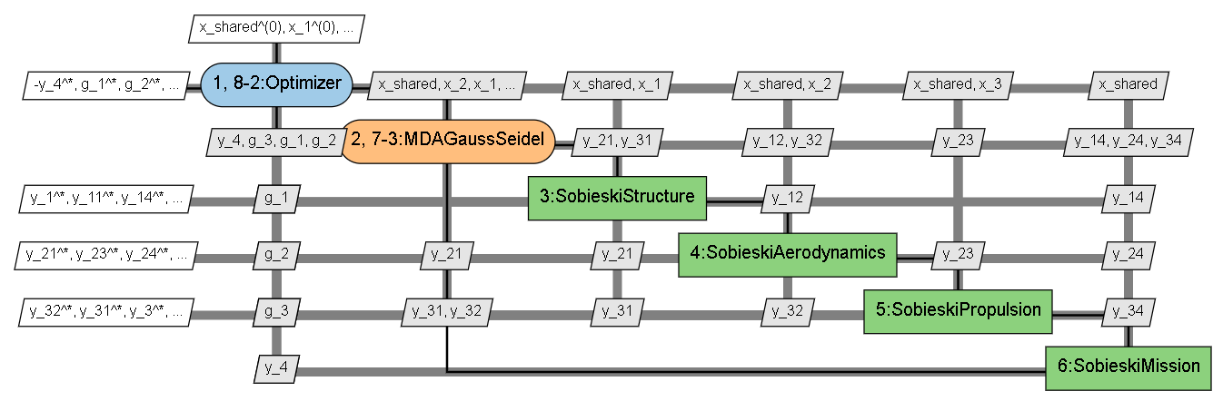
Exploration des jeux de paramètres : Exploration des jeux de paramètres : XDSM visualization of this algorithm MDF variant

Slide 85
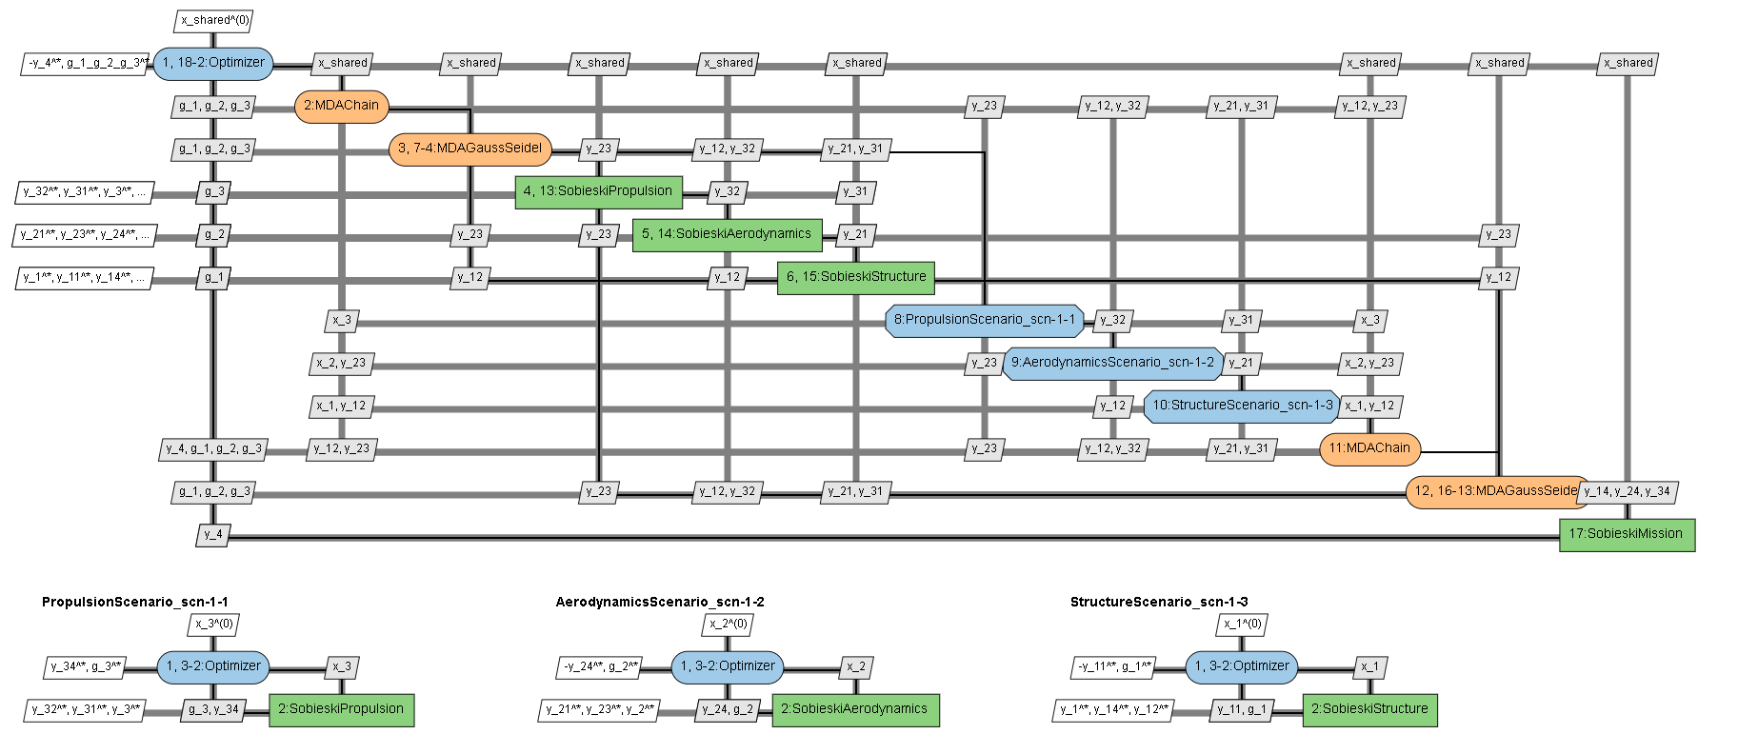
Exploration des jeux de paramètres : XDSM visualization of this algorithm Bilevel variant

Slide 86
Exploration des jeux de paramètres : XDSM visualization of this algorithm Bilevel variant
ON GOING
Différents examples de bilevels on été créés :
- en jouant sur les options (pas que les défauts)
et les sous sénarios construits
et le choix des variables et de leur rôle
pour mieux capturer tout le spectre des séquences utilisateurs nécessaires

Slide 87
Les types de formulations
1) Available types of formulations:
DisciplineOpt = 1D chains
MDF
IDF
Bilevel
Combine formulations
2) Combinaison et validation
On peut construire en mélangeant …
C’est un constructeur d’algo mais pas de validation de cette algo .
Cependant on peut le jouer et si il donne un meilleur point de design c’est OK pour l’utilisateur qui de toute façon n’aurait rien pu faire d’autre.
Formulation et équivalence mathématique : on ne sais pas à besoin de théorèmes … → recherche avec chercheur en math appli on going à l’IRT

Slide 88
Input process : create a scenario (for MDF/IDF/Bilevels …)
Analyser : définition du problème
vs définition de sa/ses résolution(s)
vs son utilisation dans différentes studies
pas de ressaisie d’input
cohérence des vues (instances)
Remark : process ok for IRT
Select transverse formulation options:
design_space, disciplines or sub-scenarios,
objective_name,
maximize_objective
and
specifics associated options
Select Scenario type (“MDO” or “DOE)
Select Formulation
Select associated formulation sub-options
Dynamic list
depending on
the formulation options
Select scenario inputs:
'max_iter‘
'algo'
Dynamic list depending on
the formulation
Create lists of disciplines or scenarios
Inputs can have
been created before
in variables or dictionaries !
Here the Design Space
of the scenario is the filtered
DS on free used variables
Create “Design Spaces”
Select scenario options:
…
Execute scenario
Here a Design Space is a list of variables with lb,v,ub,type
In GUI i/o table is a list of variables with roles :
it is not displayed in python script UI
Dynamic list depending on the algo

Slide 89
Analysis of the previous User’s activity diagram (Discussion reunion 27/01/2021)
Il est importance de visualiser la formulation et le problème : c’est un processus itératif
La listes des options disponibles est obtenues par des commandes gemseo (back-end)
On a besoin d’un arbre dynamique des paramètres et de sauvegarder les différentes listes d’inputs faites par l’utilisateur … qui peut revenir en arrière ou essayer une nouvelle branche et revenir sur la précédente …
Importance du build pour réaliser les studies …
Importances de .add_observables … gemseo.algos.opt_problem.OptimizationProblem.add_observable (ici) : NB le mot “observable” n’est pas dans le glossary
il y a un problème sur la fonction XDSM actuelle : des améliorations sont en cours
Les formulations ne sont pas forcément bien expliquées dans la doc de gemseo mais c’est intentionnel pour des raisons d’avantage concurrentiel du coté d’Airbus
Il y a un “plugin privé airbus” : mda1 et mda2 pas dispo dans gemseo standard à nécessaire pour le GUI d’Airbus
Autre
Importance des post - treatements (visu après exe) et itération utilisateur aussi après la phase de postraitement
En phase de post traitement l’utilisateur veut aussi définir une zone (lb/up d’étude) dépendant de ce qu’il a déjà pu observer
Remarque : Les JSON schémas sont pour pour l’intégrateur, pas pour les utilisateurs finaux. Le schéma incorpore une spec et permet de faire un formulaire vérifier. C’est dans certains cas mieux que du code.
Importance du retour d’erreur : bien fait dans gemseo et à mettre danss GUI
Wrapper : voir wrapper de exe avec fichier (en QT)
https://gemseo.readthedocs.io/en/stable/interface/exe_discipline.html

Slide 90
Input process : create a list of disciplines (or scenarios)
Create lists of disciplines or scenarios
Process
to be described

Slide 91
Input process : create “Design Space”
Process
to be described
Create “Design Spaces”

Slide 92
Quid des DoE avec/sans formulation ?
Select Scenario type (“MDO” or “DOE)
Select Formulation
Quid des DoE avec/sans formulation ?
DoE without optimization
Yes we need to have DoE without optimization, but in this case, the user wants to precise “observables”
2. DoE with optimization
Yes we need to have DoE with optimization : in this case, it is like an optimization with another type of algorithm based an exploration and max of explored points
3. DoE (also MDO) without formulation
Yes we need to have DoE without formulation as it is what is user’s used to have for doing explorations based on DOE
4. MDO without formulation
Yes we need to have MDO without formulation (i.e. MDF) as it is what is user’s used to have (or to define jhis optimization problem) but in most industrial cases he will require formulation to succeed in doing its optimization
5. MDO with formulation
Yes we need to have MDO with formulation as in most industrial cases he will require formulation to succeed in doing its optimization
4. Doe with formulation
If it is a DOE with optimization then it is : yes we need it → same answer as for MDO
If it is a DoE for exploration : François thinks that even in this case … it is needed and useful for the user

Slide 93
DoE et choix d’une variable obj
Dans le cadre d’une DoE l’utilisateur DOIT aujourd’hui fournir une fonction objective.
Cette variable sélectionnée est d’avantage « un observable » particulier qu’une fonction objective.
On demande à l’utilisateur de mettre le focus sur une des colonnes de la tables des résultats de simulation.
Par défaut la valeur minimale de cette variable sera fournie.

Slide 94
Questions complémentaires par pure curiosité ?
Iterative DoEs algo: what about more advance doe algorithms ? Are they already in Gemseo ?
Adaptative DOE/meta-modelling adaptative recursive
approach/sequential design/variable modelling/active learning/Surrogate based optim (SBO)
Adaptative doe method may fulfil several “objectives” as metamodeling fitting, optimisation or design-space exploration
https://www.mechanics-industry.org/articles/meca/pdf/2015/06/mi140236.pdf
→ est-ce dans ces cas que l’association DOE + Formulation est utile ?
2. MDO typology : classification des problems d’optimisation en grandes dimensions
e.g. Minoux, programmation mathématiques T2 §8 Résolution des problems de grandes dimensions : programmation linéaire généralisée et techniques de decomposition p 65 Structure des problems d’optimization
Type 1 : structure bloc-diagonal avec contraintes couplantes → decomposition par les prix ou affectation seconds membres
Type 2 : structure bloc-diagonal avec variables couplantes → decomposition par les variables
Type 3 : structure bloc-diagonal avec contraintes et variables couplantes
Est-ce que gemseo et les formulations ne traitent que le Type 2 ou aussi le type 1 ?

Slide 95
9. Construction de l’interface adaptée (avec formulation)

Slide 96
Construction de l’interface adaptée
ON GOING

Slide 97
The end

Slide 98
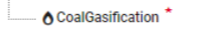
I/O variables of a DoE study with min/max evaluation of an objective variable
Gemseo Mockup
Study
Study Name :
DoE optim LHS
Copy
SellarCoupling
Disciplines
Sellar_1
I/O variables
Study Param
Run Param
Results
Sellar_2
Variable name | Array Dim (Shape) | Data Type | I/O Type | Coupled type | Study Variable Role | Units | (Lower, Upper) | Value
x | 1 | float | IN | Local | Design Variable | --- | (1,2) | 1.2
z | 2 | float | IN | Shared | Design Variable | --- | ((1,2,1.2),(1,2,1.2)) | (1.2,1.2)
y_1 | 1 | float | OUT | Coupled | Response | --- | (1,2) | 1.2
y_2 | 1 | float | OUT | Coupled | Response | --- | (1,2) | 1.2
cost | 1 | float | OUT | Response | Min Objective
c1 | 1 | float | OUT | Response | Neg Constraint
c2 | 1 | float | OUT | Response | Neg Constraint
Sellar_3
Studies
Simple run
DoE LHS n 50
DoE LHS n 100
MDO MDF SLSQP 20
DoE optim LHS
DoE LHS x=1.2
DoE optim LHS x=10
Custom DoE
Sensibility
Same Table as for an MDO optimisation problem : the choice between MDO algos or DoE algos is made in Study Param

Slide 99
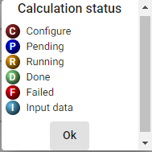
View by studies with filter on a study :
from simple to complex (great number of disciplines or/and variables)
Gemseo Mockup
Study
Study Name :
DoE LHS n 100
Quit
View by: Studies
By List/Study/Discipline
Hierarchical tree view of variables (based on several dataframe?)
Add Study
Filter : DoE LHS n 100
DoE LHS n 100
SellarCoupling
I/O variables
Study Param
Run Param
Results
Disciplines
Variable name | Array Dim (Shape) | Data Type | I/O Type | Coupled type | Study Variable Role | Units | (Lower, Upper) | Value
x | 1 | float | IN | Local | Design Variable | --- | (1,2) | 1.2
z | 2 | float | IN | Shared | Design Variable | --- | ((1,2,1.2),(1,2,1.2)) | (1.2,1.2)
y_1 | 1 | float | OUT | Coupled | Response | --- | (1,2) | 1.2
y_2 | 1 | float | OUT | Coupled | Response | --- | (1,2) | 1.2
cost | 1 | float | OUT | Response | Response
c1 | 1 | float | OUT | Response | Response
c2 | 1 | float | OUT | Response | Response
Sellar_1
Sellar_2
Sellar_3
One study applied on a combined
discipline is what we have
today in WhatsOpt or SoSTrades

